Slide 1
Argo Workflow
OW
https://www.openwriteup.com

Slide 2
Trainer Intro
Trainer Experience in IT: Overall 18 years of experience
Experience in topics: Devops ,SRE
Production Experience if any:15 years of industry experience
Objective of this course : Need for Workflow, Argo Workflow, Syntax, Blocks, Integration with k8s, Use cases
Deliverable for the trainees: Argo Workflow

Slide 3
Agenda
Introduction
Why Argo Workflow
Overview
Architecture
Setup
Controller and Argo Server
RBAC
Workflow Spec

Slide 4
..
Argo Cli
Templates
Argo input and Output parameters
Volume and secret mapping
Script block
Loop and conditional statement
Sidecar
Recursive function
Exithandler

Slide 5
..
Artifacts
Configuring Artifacts
WorkflowTemplate
ClusterWorkflowTemplate
Cron Workflow
Argo Agents
Container Set

Slide 6
..
Argo Events
Event Source
Event Bus
Trigger
Sensors
Project with git source
S3 update

Slide 7
Projects
K8s Project
CI Project
CICD projects

Slide 8
Overview
Argo workflow is an opensource container native workflow engine for orchestration jobs on Kubernetes. Argo workflow is implemented as a Kubernetes CRD (Custom Resource Definition).
Argo Workflows lets you define and run complex job sequences on Kubernetes, using containers for each step and leveraging Kubernetes' native capabilities for managing these workflows.
As the part of prerequisites, Kubernetes environment must be available to setup Argo Workflow, since it is going to implement the workflow on top of it.

Slide 9
Why Argo Workflow?
In case of complex workflow, when we have multiple stages in Kubernetes environment. Argo workflow solves that complex workflow multiple steps, dependencies and conditions.
It provides a UI interface, where we can see all the activities happening on the argo side. Logging and monitoring on each stage is well integrated. Scaling up and version control is also well managed.
As a solution, Argo workflow provides single windows for complex workflow on Kubernetes environment

Slide 10
..
Handles Complex Schedules: Argo Workflows can manage many tasks that need to be done in a specific order or that depend on each other. It makes sure everything happens at the right time.
User-Friendly Interface: It provides a dashboard where you can see all the activities and their progress. This is like having a digital organizer where you can track everything in real-time.
Logging and Monitoring: Argo Workflows keeps detailed records of what's happening at each step. If something goes wrong, you can easily find out what and where it happened.

Slide 11
Argo Workflow Architecture
There are two Deployments:
Workflow Controller
Argo Server
Workflow Controller: It takes care of reconciliation process. It has bunch of workers who are responsible for handling tasks, these tasks are to-do-list called workers, put in a special queue whenever something new added or updated.
Argo Server: Handles all the workflow, coordinates task and ensures everything running fine. It is backbone of Argo workflow.

Slide 12
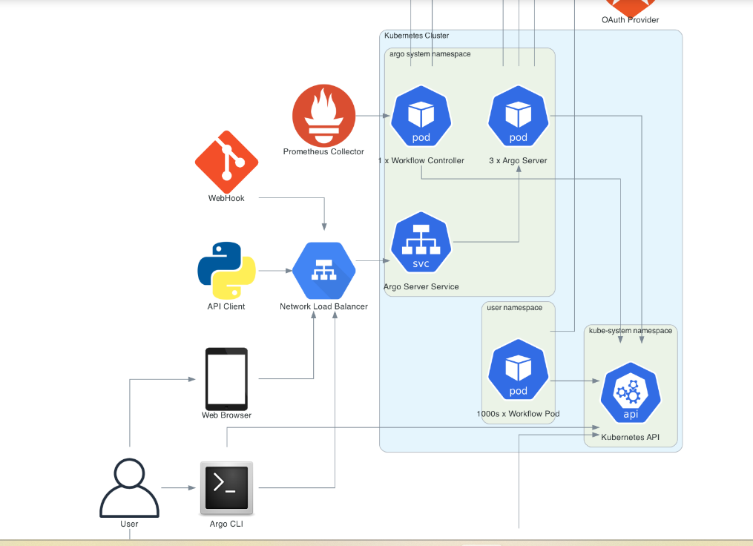
..

Slide 13
..
In the above diagram, we have Argo namespace. In Argo namespace Workflow controller and Argo server is running, and Argo server is connected to Argo Server Service.
As well to communicate Argo, we have Argo cli and Argo UI option are available.
The Workflow Controller and Argo Server both run in the argo namespace

Slide 14
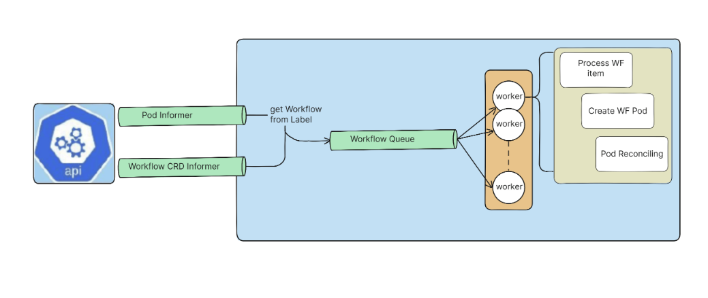
Workflow Controller
Notes:
the diagram explains how Argo Workflows manages the process of handling tasks. It has a system in place where workers (goroutines) are informed about new tasks (workflows) through a communication system (informers) and then process them one at a time to ensure everything runs smoothly and efficiently. This way, your production line (workflow) is well-organized and controlled.

Slide 15
..
Reconciliation Process: This is like the factory manager who oversees that everything is running smoothly. The manager ensures that each product (or workflow) is being processed correctly according to its specific steps.
Worker Goroutines: These are like the factory workers. Each worker is responsible for handling a specific part of the workflow. They work on the tasks that are assigned to them.
Workflow Queue: This is like the conveyor belt in the factory. All the workflows (products) that need to be processed are placed on this conveyor belt. The workers pick up the workflows from here and start processing them.

Slide 16
..
Adds and Updates: This is when new products are added to the conveyor belt or existing products are updated with new instructions.
Informers: Think of these as the communication system in the factory. They inform the workers about new products or updates. There are different informers for different types of tasks and workflows, making sure everyone knows what they need to d

Slide 17
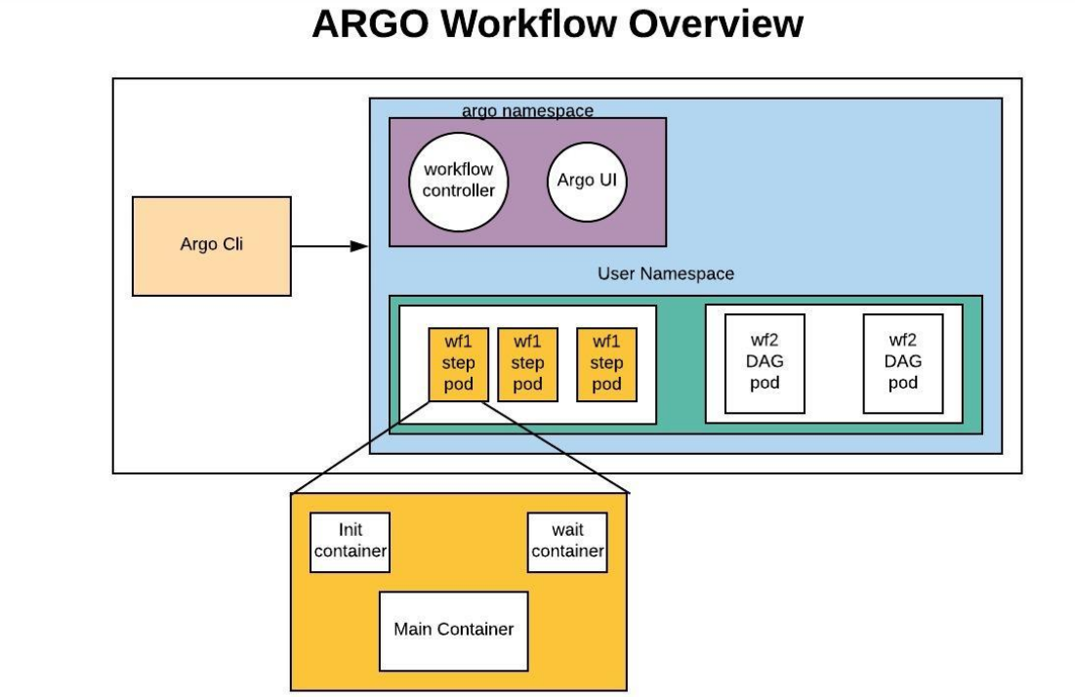
Argo Internals

Slide 18
..
The internals of a Pod are also shown. Each Step and each DAG Task cause a Pod to be generated, and each of these is composed of 3 containers:
main container runs the Image that the user indicated, where the argoexec utility is volume mounted and serves as the main command which calls the configured Command as a sub-process
init container is an InitContainer, fetching artifacts and parameters and making them available to the main container
wait container performs tasks that are needed for clean up, including saving off parameters and artifacts

Slide 19
Main Container
Purpose: Runs the main task that the user wants to perform.
How it works:
It runs the image specified by the user.
It includes the argoexec utility, which helps manage the task.
The argoexec utility runs the main command as a sub-process.
Manages input and output artifacts and parameters.

Slide 20
Init Container
Purpose: Prepares the environment before the main container starts.
How it works:
It fetches necessary artifacts (files, data) and parameters (settings).
It makes these artifacts and parameters available to the main container.

Slide 21
Wait Containers
Wait Container:
Purpose: Cleans up after the main task is done.
How it works:
It performs tasks needed to tidy up.
It saves off any output parameters and artifacts produced by the main container.

Slide 22
Summary
When a task is run, a Pod is created, consisting of three containers:
Init Container: Sets up everything needed for the task.
Main Container: Runs the task.
Wait Container: Cleans up and saves results.

Slide 23
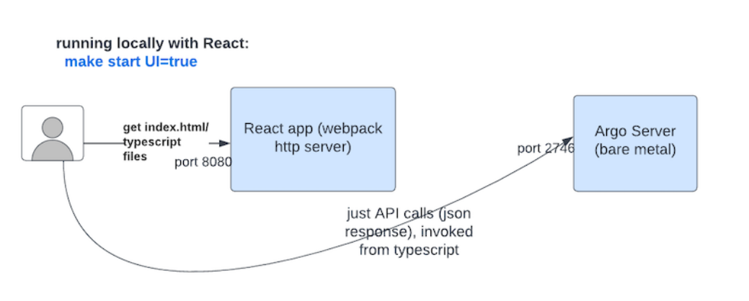
UI Interface

Slide 24
.
Running "make start UI=true": Think of this as pressing a button that starts up your project with a UI so you can see and interact with it.
React Application: This is the part of your project that handles what you see and interact with in your web browser. It’s built using a technology called React.
Webpack HTTP Server: This is like a local mini-web server that runs on your computer. It handles showing the web pages (like index.html) and other files you need for your UI. It runs on port 8080, which is like its address on your computer.

Slide 25
..
index.html and TypeScript Files: These are the building blocks of your web application. The index.html file is the main webpage, and TypeScript files contain the code that makes your webpage dynamic and interactive.
Back-End API (Argo Server): This is the part of your project that handles data and logic on the server-side. When your UI needs to get or send data, it talks to the back-end API. This back-end server runs on port 2746.
Hot Reload: Imagine you are editing a document, and every time you make a change, the document automatically updates without you having to save and refresh it.

Slide 26
Lab1: Setup
Prerequisites:
In this session we will be using ubuntu 22.04 server, All the prerequisites already followed:
Docker installation: https://www.openwriteup.com/?page_id=785
Kubernetes setup: https://www.openwriteup.com/?page_id=866
Untainted the master (As we are using single host): https://www.openwriteup.com/?page_id=887
Note: In case you are doing first time, please follow the guideline provided for docker and Kubernetes

Slide 27
Argo Server UI
The Argo Server is commonly exposed to end-users to provide users with a UI for visualizing and managing their workflows. It must also be exposed if leveraging webhooks to trigger workflows.
Both of these use cases require that the argo-server Service to be exposed for ingress traffic (e.g. with an Ingress object or load balancer). Note that the Argo UI is also available to be accessed by running the server locally (i.e. argo server) using local KUBECONFIG credentials, and visiting the UI over https://localhost:2746.

Slide 28
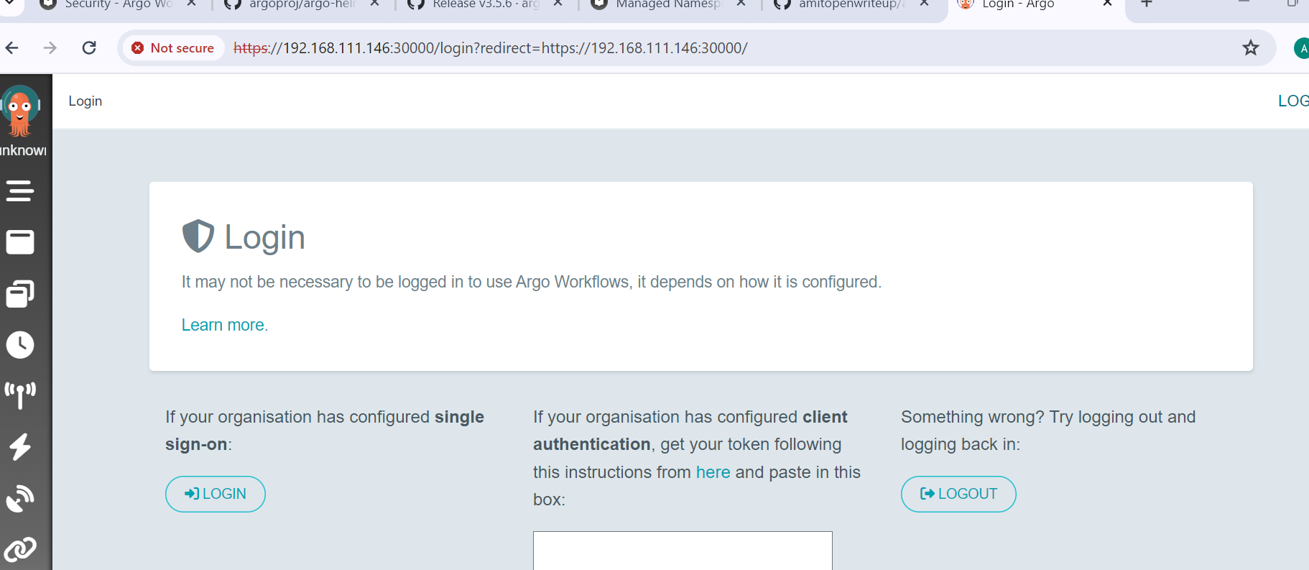
Using NodePort
In this training We will be using NodePort concept to expose it

Slide 29
Access through UI
server - in hosted mode, use the kube config of service account, in local mode, use your local kube config.
sso - since v2.9, use single sign-on, this will use the same service account as per "server" for RBAC. We expect to change this in the future so that the OAuth claims are mapped to service accounts.
client - requires clients to provide their Kubernetes bearer token and use that.

Slide 30
Using Client
Lab 2:
Set nodeport
Setup Service Account
Assign role
Generate access token

Slide 31
The Workflow : Definition
The Workflow is the most important resource in Argo and serves two important functions:
It defines the workflow to be executed.
It stores the state of the workflow.
Imagine a Workflow in Argo like a recipe for baking a cake. It's not just a list of ingredients and steps; it's also where you keep track of how far along you are in making the cake.
The Workflow isn't just a set of instructions; it's also like a diary that keeps updating as you make progress. This dual role helps you know what to do next and where you are in completing your task,

Slide 32
Workflow Spec
Workflow.spec Field: This is like the blueprint or plan for what the Workflow will do. It's where you list out all the things the Workflow needs to do.
Templates: Think of these as different jobs or tasks that the Workflow needs to perform. Each template is like a set of instructions for one specific task.
Entrypoint: This is like pointing to the main task or job that the Workflow should start with. It's like saying, "Hey, start with this job first!"
So, in simple terms, the Workflow.spec field is where you outline what needs to be done (like a to-do list), templates are the individual tasks on that list, and the entrypoint is the first task that gets done.

Slide 33
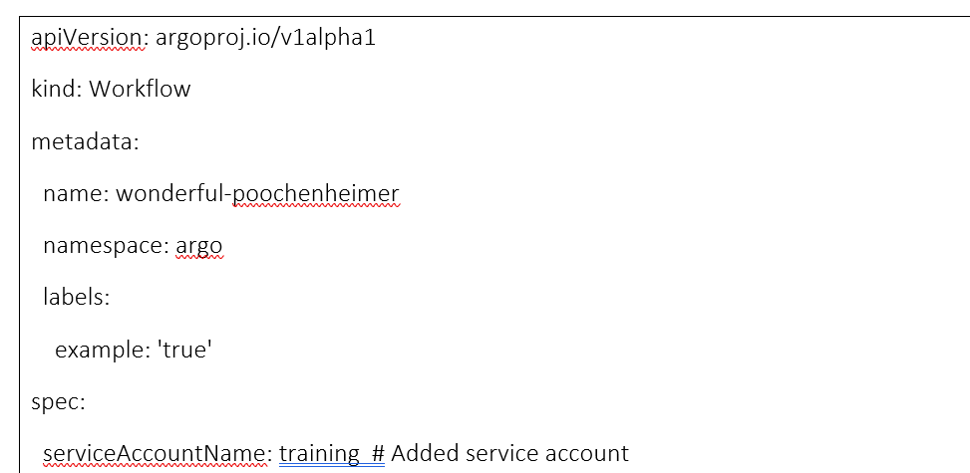
..

Slide 34
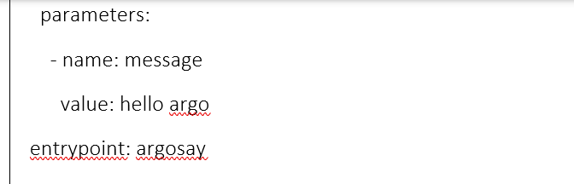
Entrypoint
Main Starting Point: The entrypoint in Argo Workflows is the first step that kicks off the entire workflow. It's like the starting line in a race, where the workflow begins executing.
Defines Workflow Path: It specifies the sequence of steps or tasks that the workflow will follow. Think of it as the main path or blueprint that guides the workflow through its various stages

Slide 35
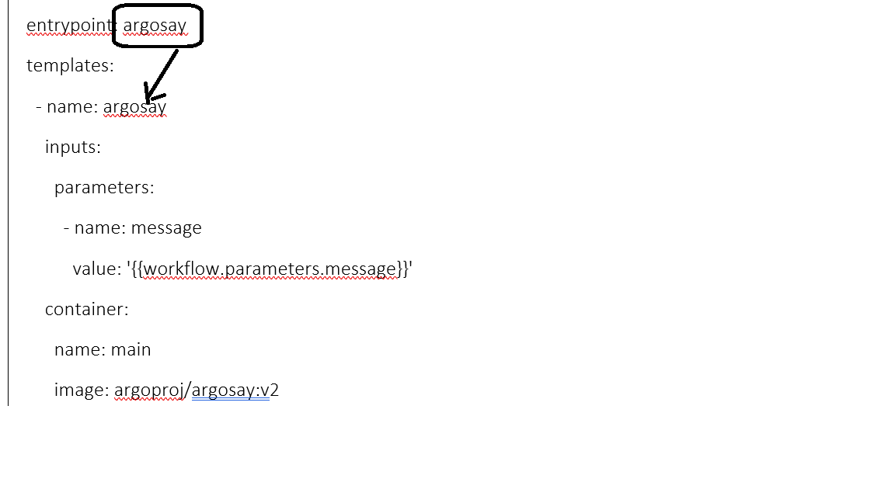

Slide 36
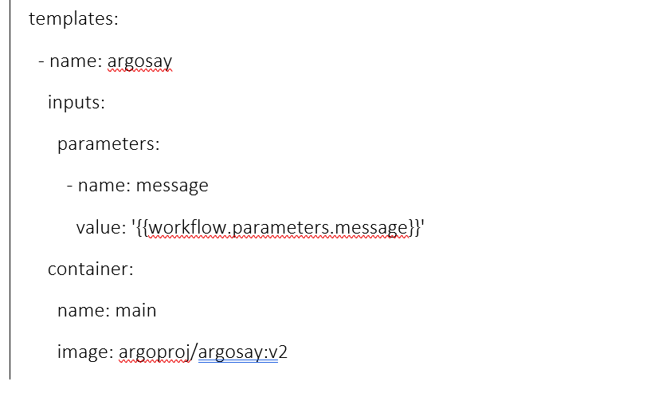
Template
A template in Argo Workflows is like a reusable blueprint or recipe for a task. It defines what actions need to be performed, such as running a script or a container, and can be used multiple times within a workflow to execute those actions.

Slide 37
Lab3
Create Workflow using Argo ui
Create Template
Check events and logs

Slide 38
Template types
Container
Script
Step
DAG
Suspend

Slide 39
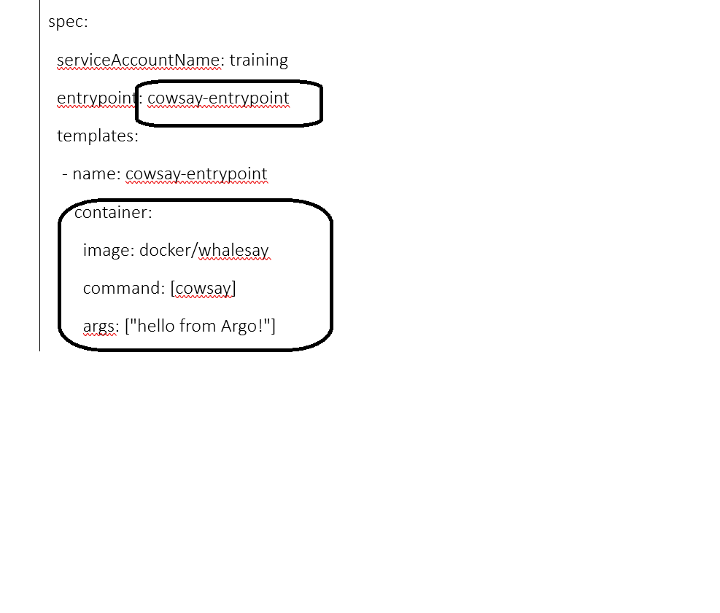
Container Template type
In Argo Workflows, a template defines a specific task to be completed, often involving running a container

Slide 40
..
The workflow is named cowsay-example and belongs to the argo namespace.
It uses the training service account (serviceAccountName: training).
The entrypoint is defined as cowsay-entrypoint, which is where the cowsay command is executed.
The cowsay-entrypoint template runs a container using the docker/whalesay image and executes the cowsay command with the argument "hello from Argo!".
The ttlStrategy specifies that completed pods will be removed after 300 seconds (5 minutes).
The podGC strategy is set to OnPodCompletion, meaning pods will be removed after they complete.

Slide 41
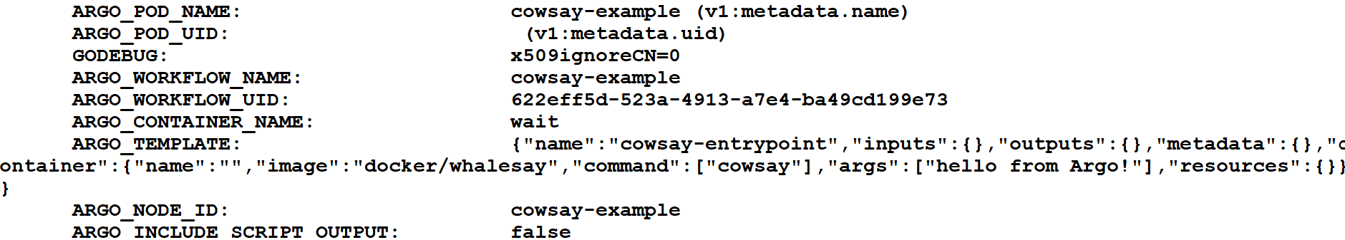
..

Slide 42
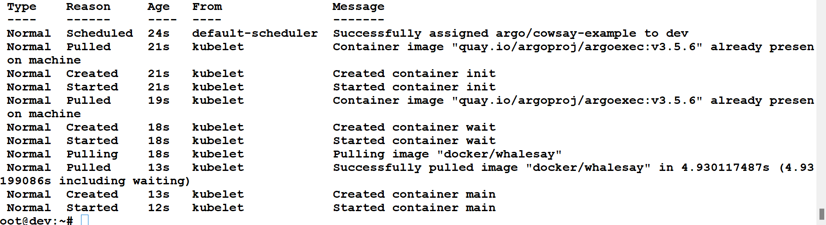
..

Slide 43
Lab 4
Try with UI
Using Argo cli

Slide 44
Script Type
A "script" in an Argo Workflow is like a handy tool that wraps around a container. It's a way to run a script inside a container without having to manage the script file separately.
Convenience Wrapper: Think of it as a convenient way to execute a script inside a container without worrying about creating or managing separate script files.
Spec Same as Container: The specifications (spec) for a script in Argo Workflow are similar to running a container. You still specify the image, command, and arguments just like you do when running a container directly.

Slide 45
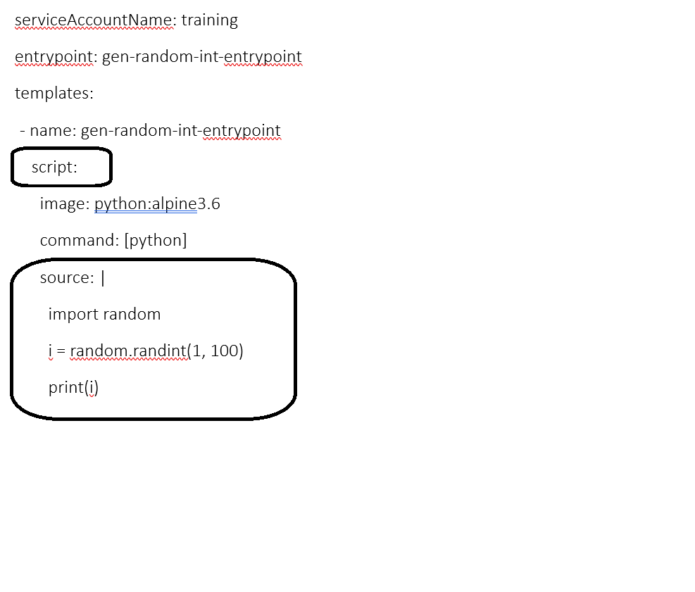
syntax

Slide 46
..
Source Field: This is where you define the script that you want to run. Instead of creating a script file and copying it into the container, you write the script directly in the YAML file using the source: field.
Execution: When the workflow runs, Argo will save the script into a file inside the container and execute it. You don't need to handle the script file creation or deletion; Argo manages that for you.

Slide 47
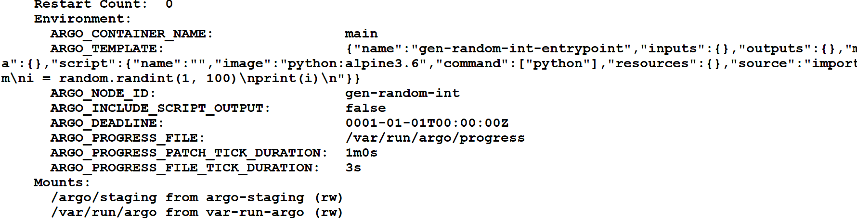
..

Slide 48
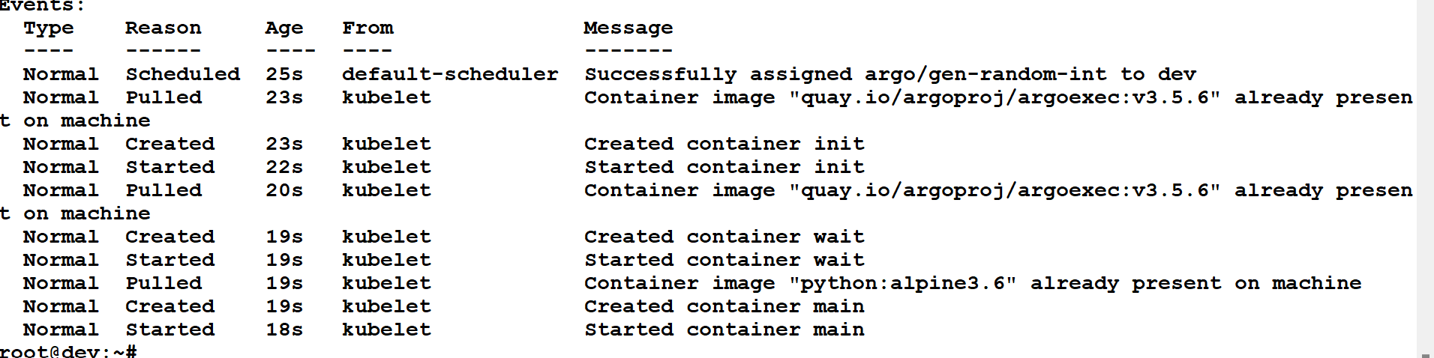
..

Slide 49
Lab5
Try Python
Assignment: use image mention in pdf, and try shell script

Slide 50
Template: Resource Type
Performing operations on cluster resources directly" means you can use Argo Workflows to do things like create, modify, or delete resources on your Kubernetes cluster without manually interacting with the cluster.
Resources such as Configmaps, we need during the workflow

Slide 51
..
Get: You can retrieve information about existing resources.
Create: You can make new resources like Pods, ConfigMaps, or Services.
Apply: This updates resources if they exist or creates them if they don’t.
Delete: You can remove resources from the cluster.
Replace: This deletes and recreates resources, ensuring they are up-to-date.
Patch: You can make changes to existing resources without recreating them entirely.

Slide 52
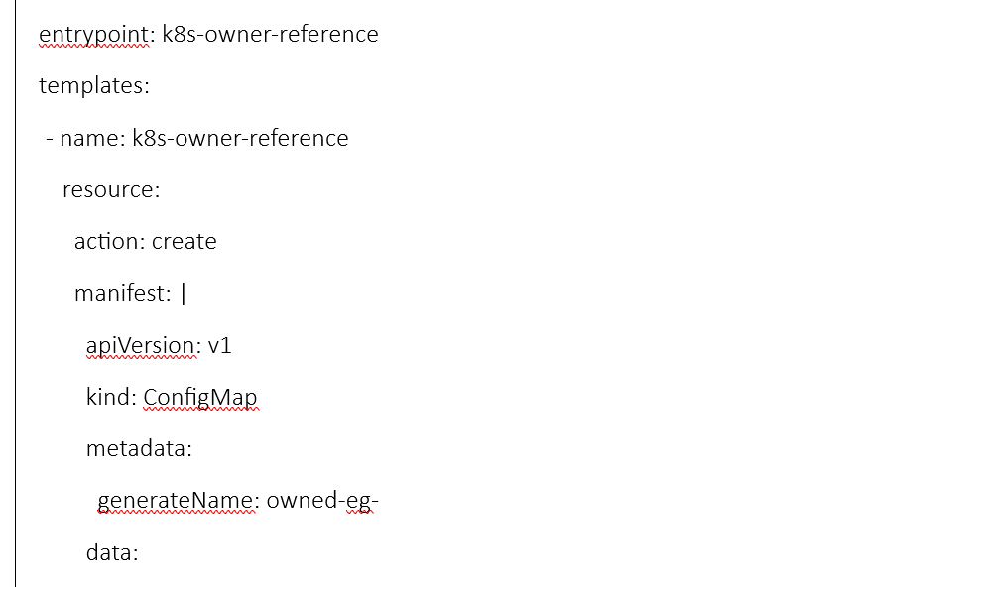
..

Slide 53
..
The workflow is named k8s-owner-reference and belongs to the argo namespace.
The entrypoint is set to k8s-owner-reference, which refers to the template that creates the ConfigMap.
There is one template defined (k8s-owner-reference) that uses the resource type to create a resource on the cluster.
The action field is set to create to indicate that this template will create a resource.
The manifest field contains the YAML description of the resource to be created. In this case, it's a ConfigMap with a generated name (generateName) starting with "owned-eg-" and containing a key-value pair (some: value).

Slide 54
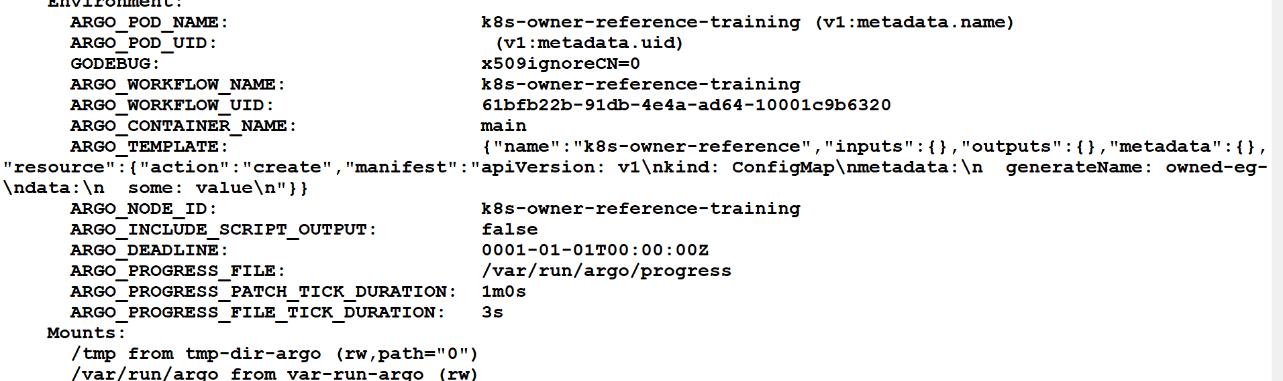
..

Slide 55
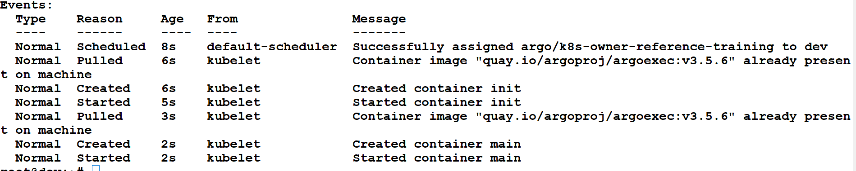

Slide 56
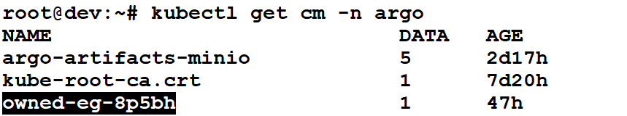
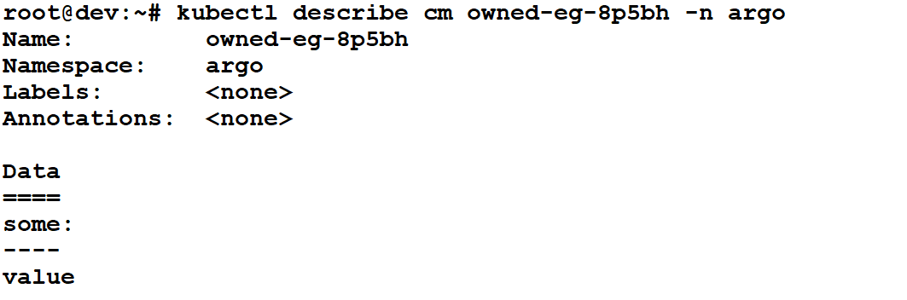
..

Slide 57
Lab 6
Configmap creation

Slide 58
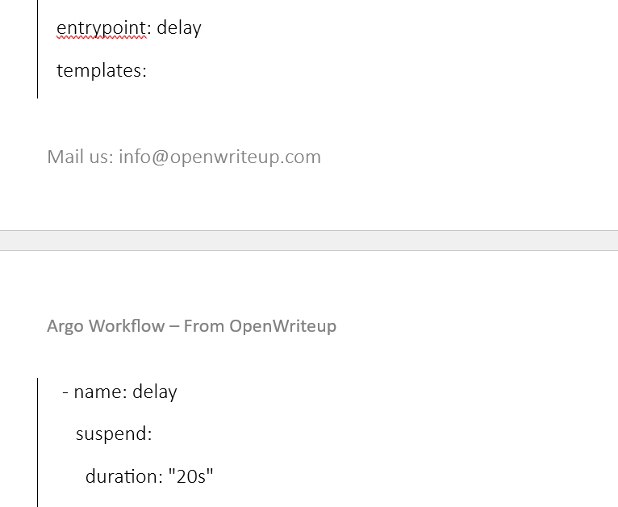
Suspend Template
A suspend template in Argo Workflow is like a pause button that temporarily stops the workflow execution.
It can be set to suspend for a specific duration or until it's manually resumed.

Slide 59
..
The workflow is named delay-example and belongs to the argo namespace.
The entrypoint is set to delay, which refers to the suspend template named delay.
There is one template defined (delay) that uses the suspend type to pause the workflow execution for 20 seconds.
The duration field is set to "20s" to specify the duration of the suspension.

Slide 60
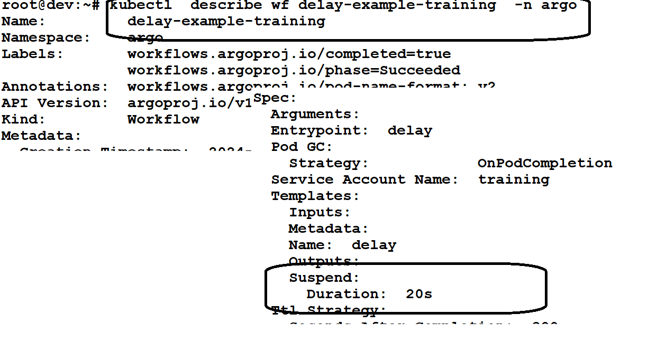

Slide 61
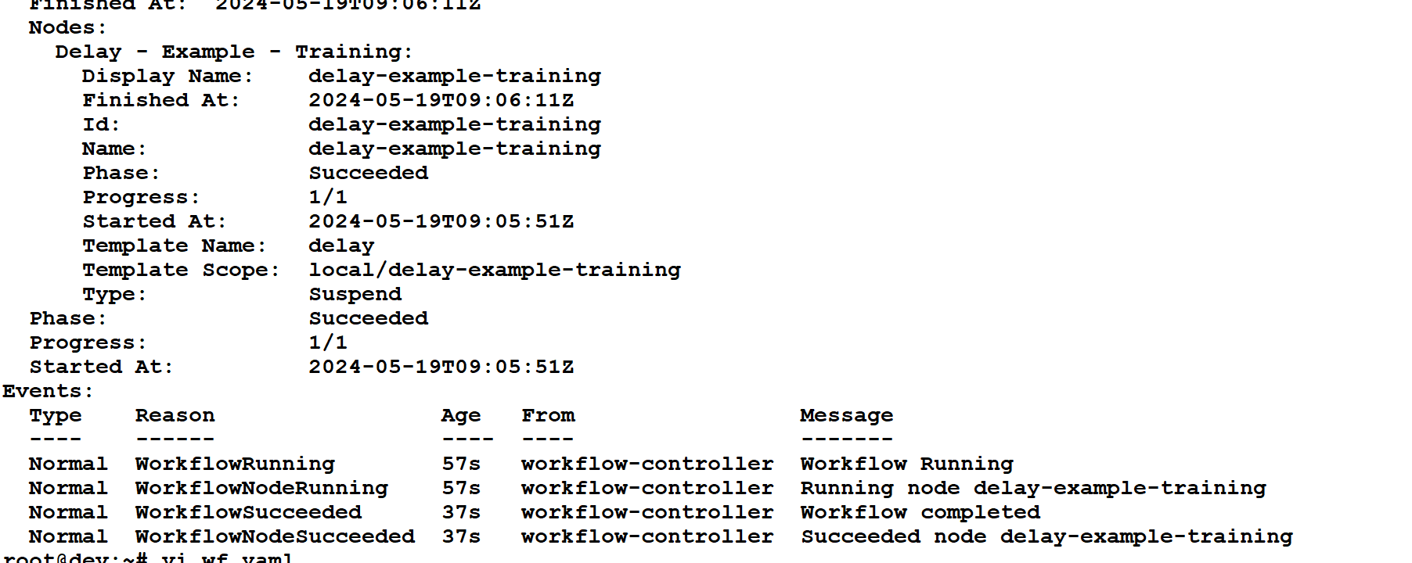

Slide 62
Lab 7
argo submit wf1.yaml -n argo
argo watch delay-example-training -n argo
kubectl describe wf delay-example-training -n argo
https://github.com/amitopenwriteup/argowf-labs/blob/main/lab7-wf.yaml

Slide 63
Template Steps
A "steps" template in Argo Workflow is like a series of instructions where you can define tasks to be performed in a specific order.
- name: hello-hello-hello
steps:
- - name: step1
template: prepare-data
- - name: step2a
template: run-data-first-half
- name: step2b
template: run-data-second-half

Slide 64
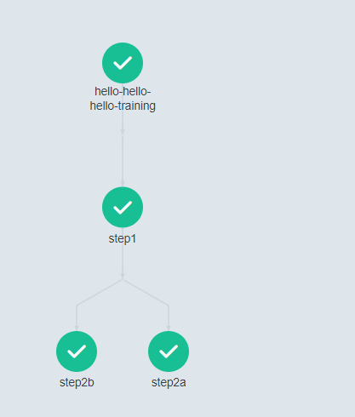

Slide 65
..
The workflow uses the training service account (serviceAccountName: training) to execute the workflow tasks.
The steps (step1, step2a, step2b) run containers with different commands to echo messages, simulating different tasks.
The entrypoint is set to hello-hello-hello, which refers to the steps template with the same name.

Slide 66
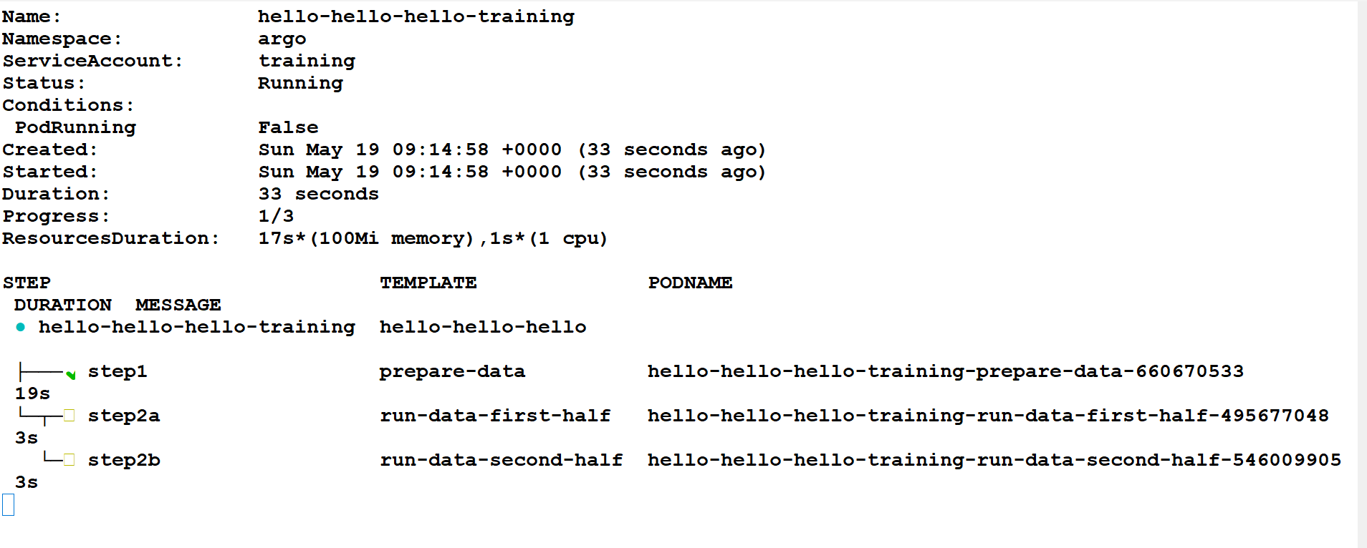
argo watch <wf name> -n <ns>

Slide 67
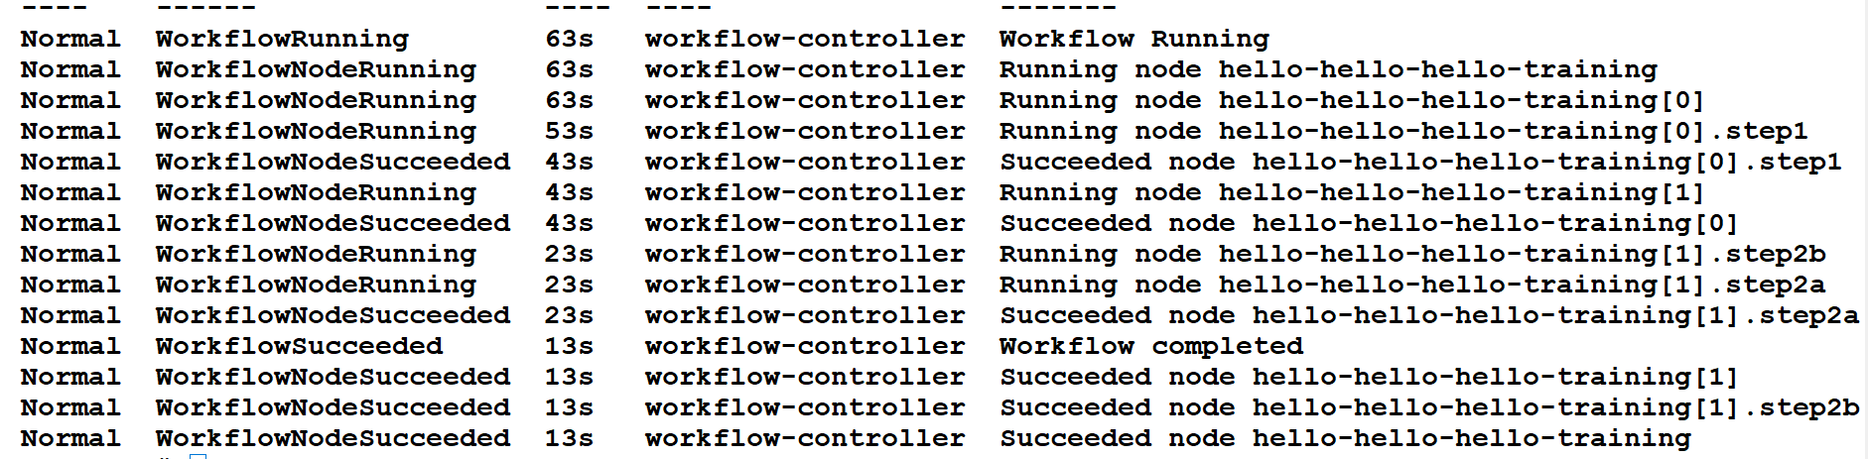

Slide 68
Lab 8
https://github.com/amitopenwriteup/argowf-labs/blob/main/lab8-wf.yaml
argo submit wf1.yaml -n argo
argo watch hello-hello-hello-training -n argo
kubectl describe wf hello-hello-hello-training -n argo

Slide 69
DAG
A Directed Acyclic Graph (DAG) template in Argo Workflows allows you to define the execution order of a series of tasks in a non-linear, acyclic manner. This is particularly useful for workflows where certain tasks depend on the outputs of multiple preceding tasks.
DAG: A DAG template consists of a series of steps (tasks) with directed edges, ensuring there are no cycles.
Tasks: Individual units of work defined within the DAG.
Dependencies: Define which tasks must be completed before others can start.

Slide 70
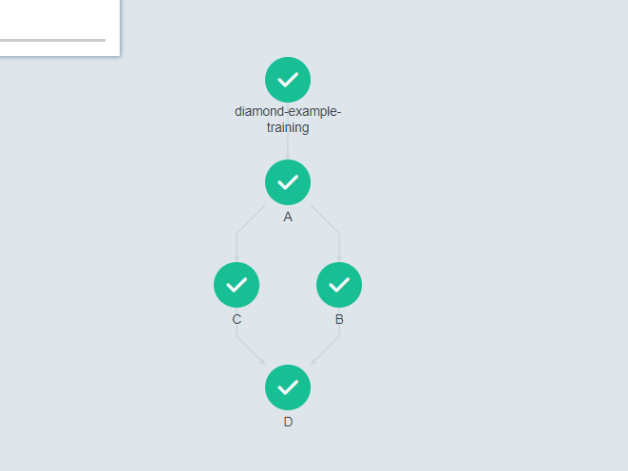
DAG

Slide 71
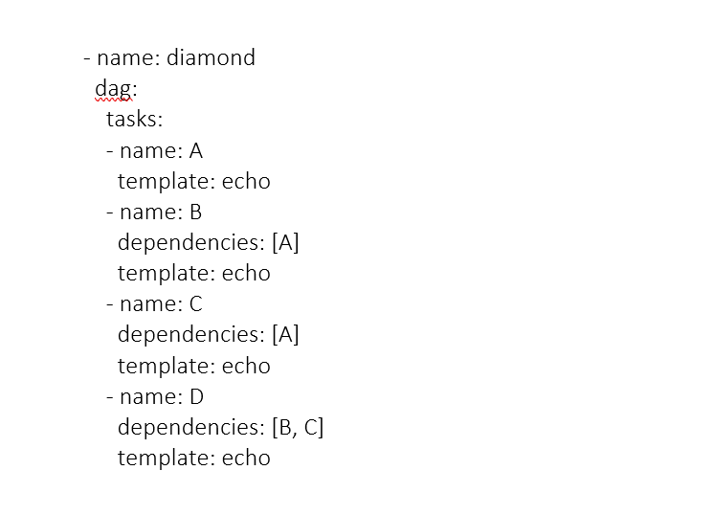
DAG template

Slide 72
..
In a DAG template, tasks are organized based on dependencies. Here's a simple explanation using your example:
Name: This is the name of the DAG template, which you can use to refer to it elsewhere in your workflow.
Tasks List: In the tasks list, you define each task along with its dependencies and the template it uses.
Task A: This is the first task and doesn't have any dependencies (dependencies: []). It runs the echo template.
Task B and Task C: Both tasks B and C have a dependency on Task A (dependencies: [A]). This means they will wait for Task A to complete before they start. They run in parallel.
Task D: Task D has dependencies on both Task B and Task C (dependencies: [B, C]). This means it will wait for both B and C to complete before it starts. Task D runs after B and C are completed.

Slide 73
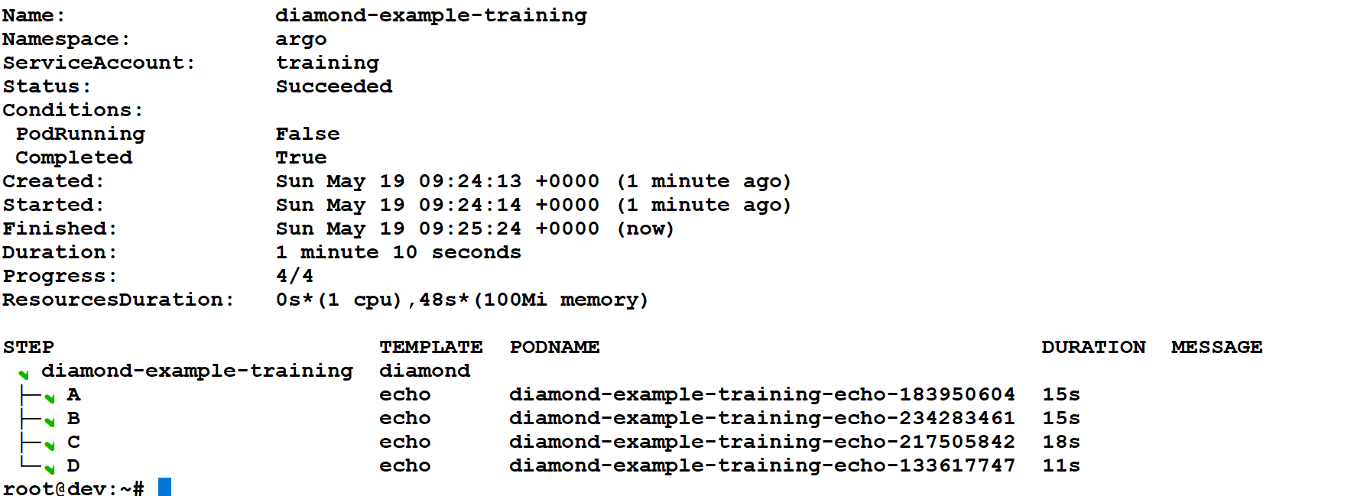
Argo watch command

Slide 74
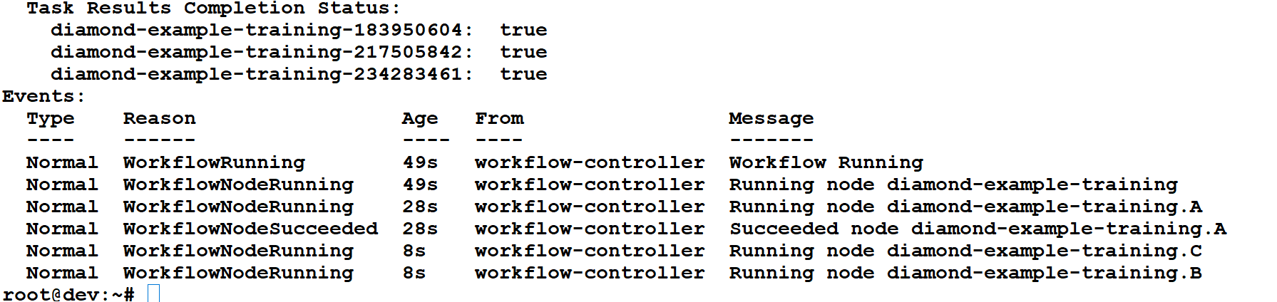
Kubectl command

Slide 75
Lab 9
https://github.com/amitopenwriteup/argowf-labs/blob/main/lab9-wf.yaml
argo submit wf2.yaml -n argo
kubectl describe wf diamond-example-training -n argo
argo watch diamond-example-training -n argo

Slide 76
Lab
Perform lab 7-9 from UI and check all the events and logs from UI

Slide 77
What is Artifacts?
Artifacts When running workflows, you often have steps that produce data.
In Argo Workflows, artifacts can be files, logs, or other data produced during a step. Here's a simple explanation of how to handle these artifacts:
Key Points
Artifacts: Data produced or consumed by workflow steps.
Output Artifacts: Data generated by a step.
Input Artifacts: Data required by a subsequent step.

Slide 78
Configuring Your Artifact Repository
To run Argo workflows that use artifacts, you must configure and use an artifact repository.
Argo supports any S3 compatible artifact repository such as AWS, GCS and MinIO.
This section shows how to configure the artifact repository. Subsequent sections will show how to use it.

Slide 79
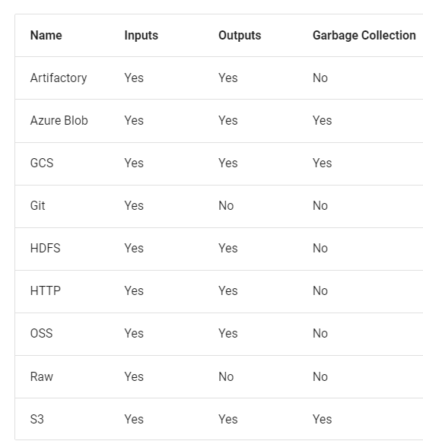
..

Slide 80
..
Create your bucket and access keys for the bucket. AWS access keys have the same permissions as the user they are associated with.
In particular, you cannot create access keys with reduced scope. If you want to limit the permissions for an access key, you will need to create a user with just the permissions you want to associate with the access key. Otherwise, you can just create an access key using your existing user account.

Slide 81
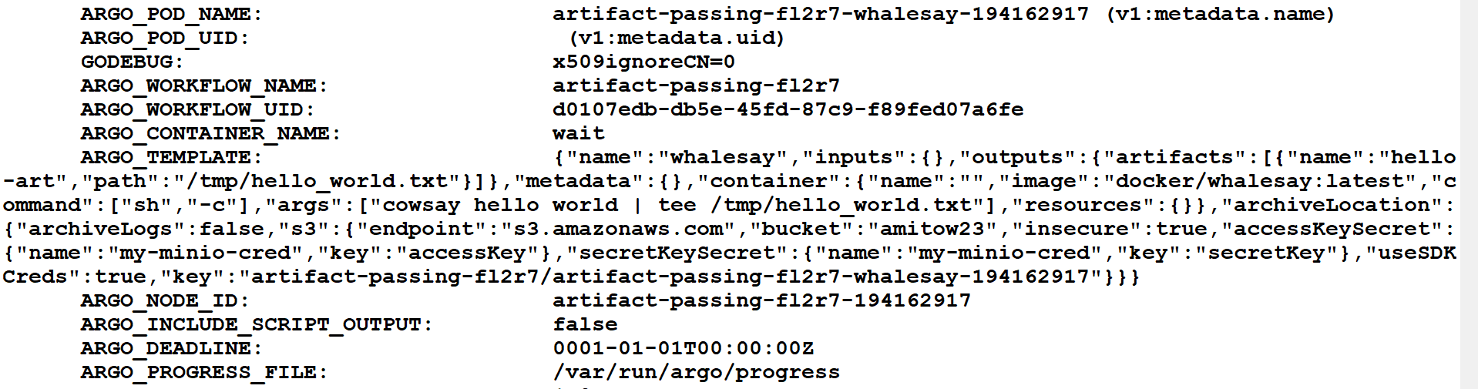
Artifacts

Slide 82
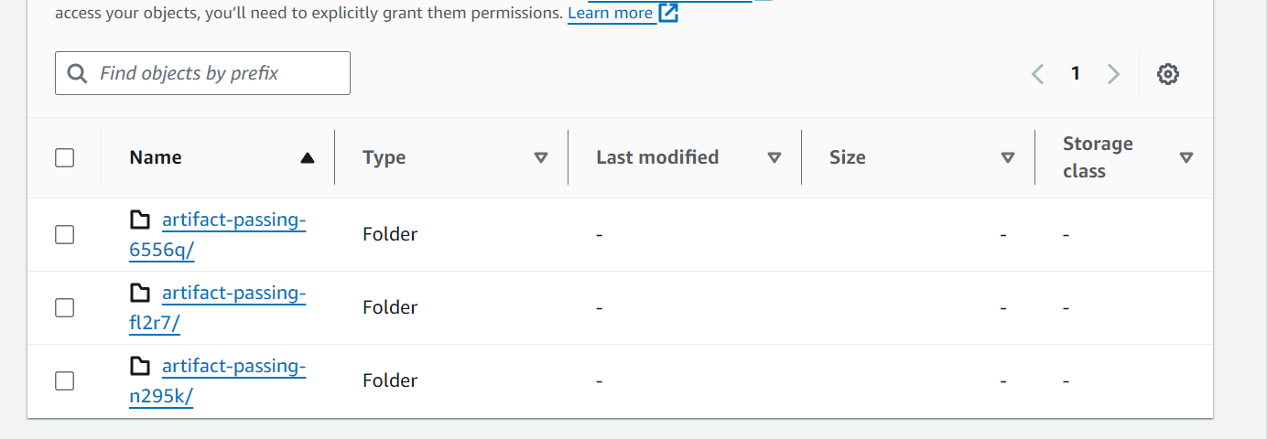
S3 bucket

Slide 83
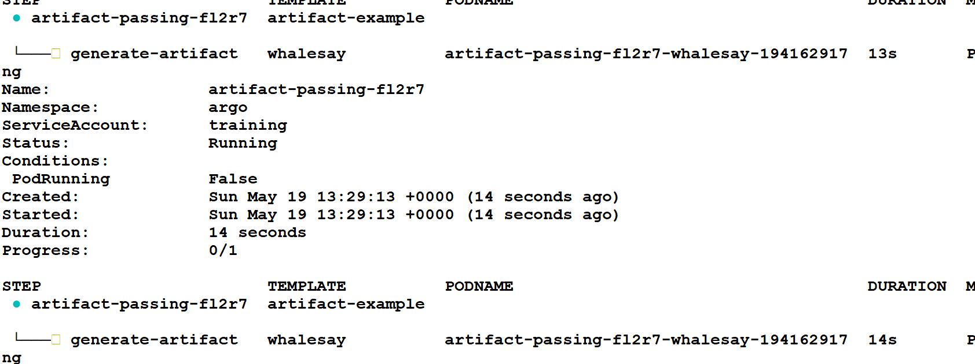
Watch output

Slide 84
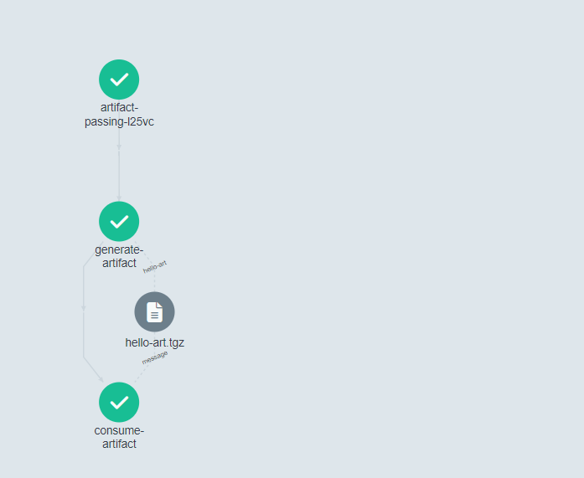
Lab10 and Lab 11
Setup antifactory on aws S3 bucket
Lab Artifacts labs using steps

Slide 85
Output Parameters
Data produced by a step that can be used by subsequent steps.
Can be used with any type of step, not just script
Different from artifacts, which are typically files or larger data blobs.
Allow for more flexible and dynamic workflows.
Suitable for conditional tests, loops, and arguments.

Slide 86
Generate Output: A step generates an output and writes it to a file.
- name: generate-parameter
container:
image: alpine:3.7
command: [sh, -c]
args: ["echo 'Hello, Argo' > /tmp/message.txt"]
outputs:
parameters:
- name: message
valueFrom:
path: /tmp/message.txt

Slide 87
Use Parameters
- name: use-parameter
template: display-message
arguments:
parameters:
- name: message
value: "{{steps.generate-parameter.outputs.parameters.message}}"

Slide 88
Display message
- name: display-message
inputs:
parameters:
- name: message
container:
image: alpine:3.7
command: [sh, -c]
args: ["echo {{inputs.parameters.message}}"]

Slide 89
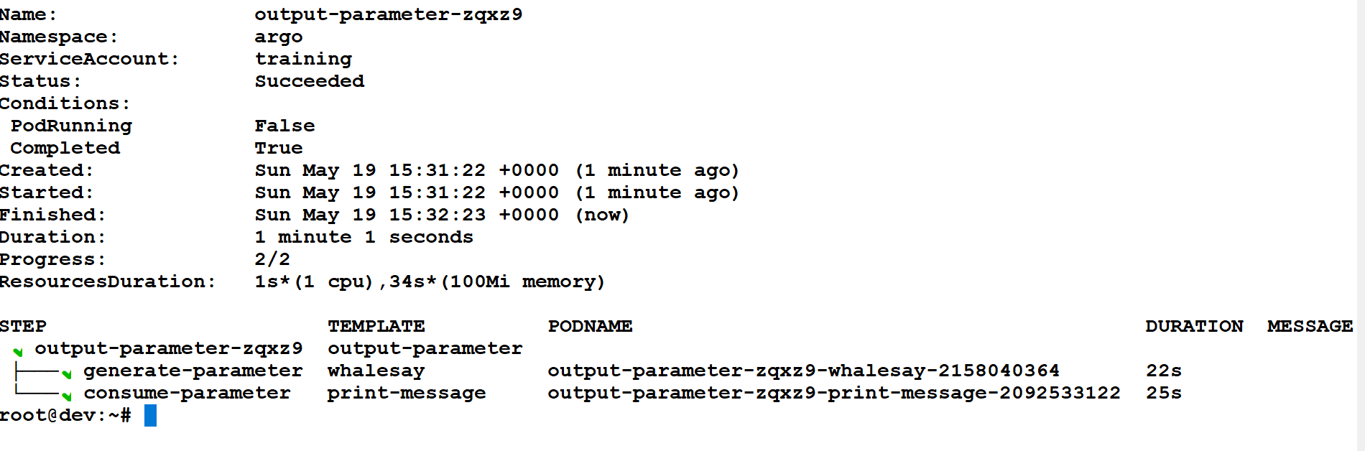
..

Slide 90
Lab 12
All three ways will be used

Slide 91
Accessing Secrets in Argo Workflow
Secrets:
Definition: Sensitive information like passwords, tokens, or keys.
Managed securely in Kubernetes.
Argo supports Kubernetes secrets mechanisms.
Access secrets as environment variables or volume mounts.
Define a secret in Kubernetes.
Use the secret in an Argo Workflow.

Slide 92
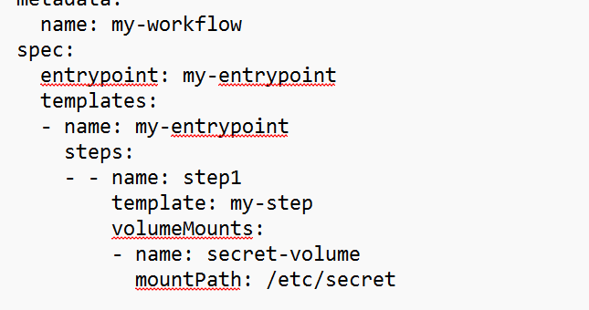
..

Slide 93
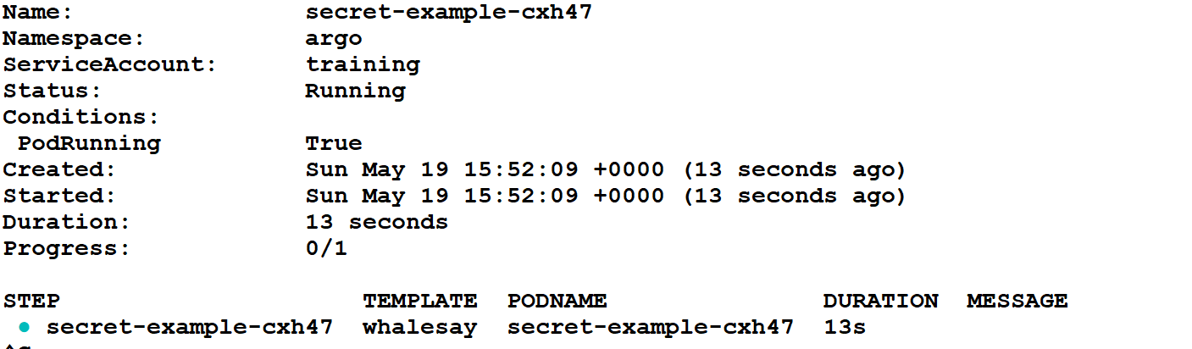
Argo watch

Slide 94
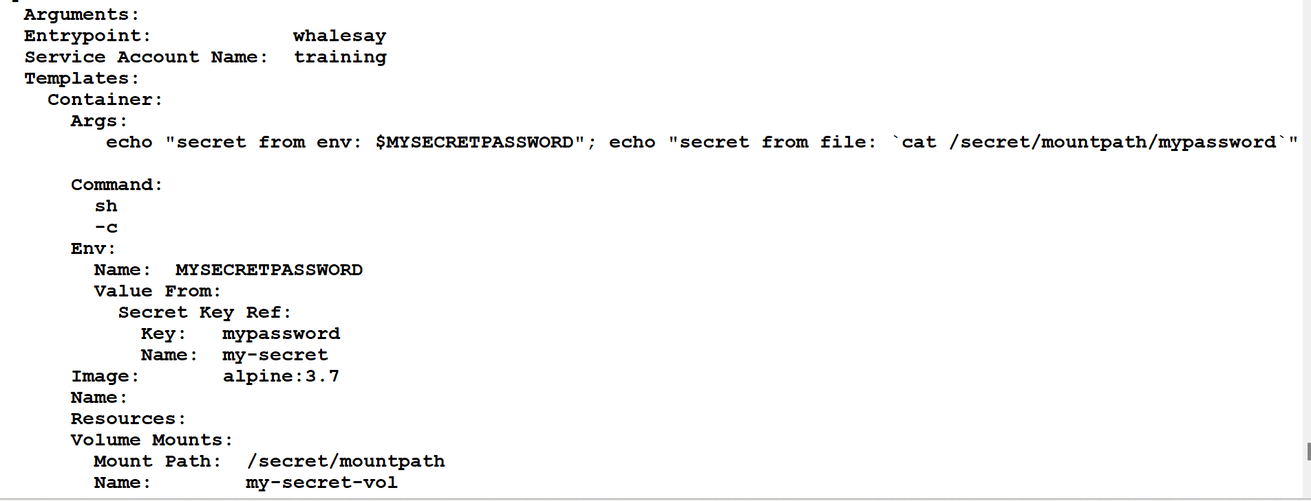
..

Slide 95
Lab 13
Create Secret
Map the secret in the Argo workflow

Slide 96
Accessing Existing Volumes in Argo Workflows
apiVersion: v1
kind: PersistentVolumeClaim
metadata:
name: my-pvc
spec:
accessModes:
- ReadWriteOnce
resources:
requests:
storage: 1Gi

Slide 97
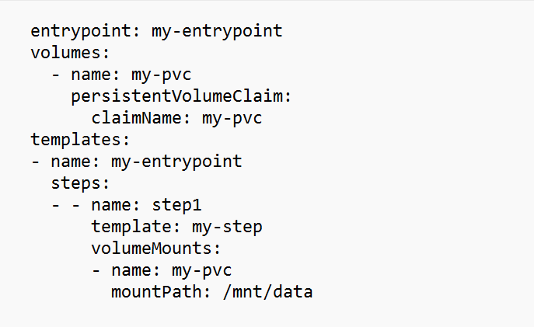
..

Slide 98
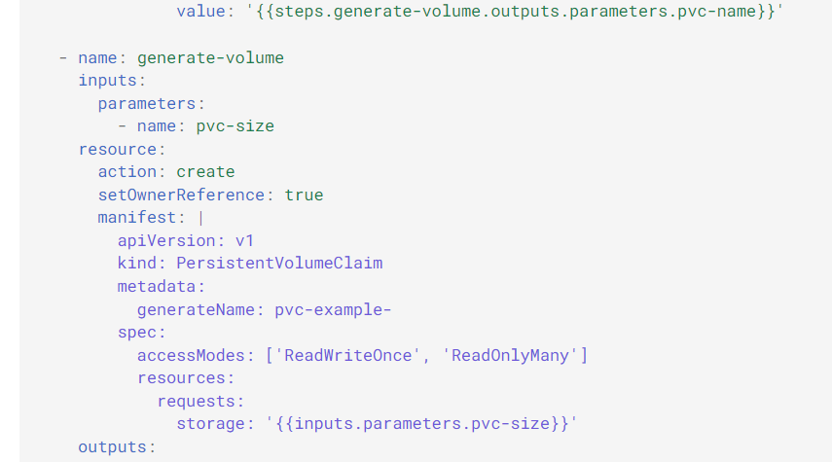

Slide 99
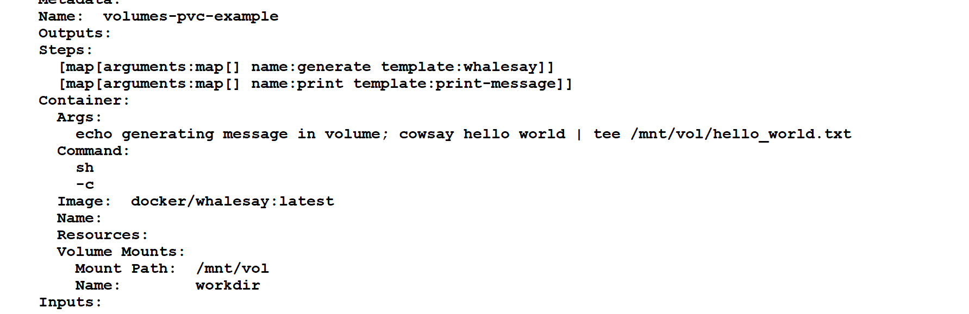
..

Slide 100
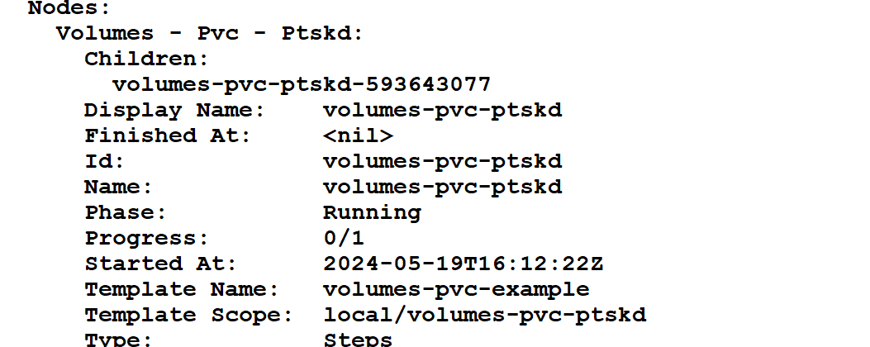
..

Slide 101
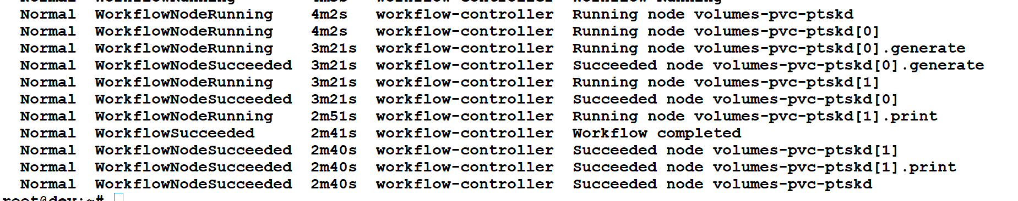
..

Slide 102
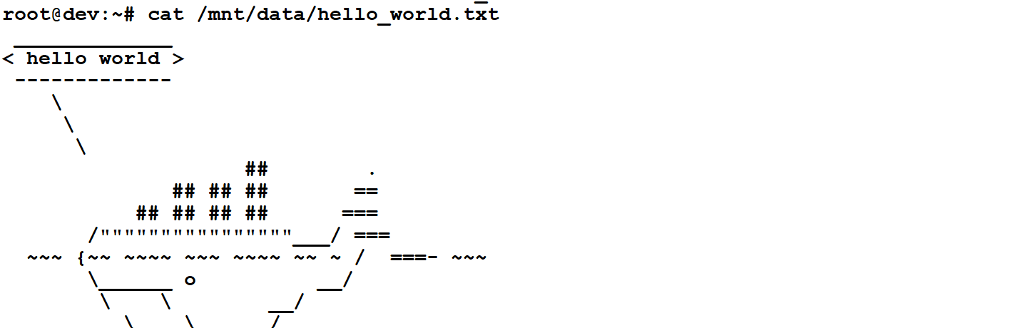
..

Slide 103
Lab 14
Create Pv first using kubectl
Create Argo workflow using UI

Slide 104
Performing Loops in Workflows
Three basic ways of running a template multiple times in Argo:
withSequence: Iterates over a sequence of numbers.
withItems: Takes a list of things to work on, either single values or a JSON object.
withParam: Takes a JSON array of items, allowing for dynamic workflows.

Slide 105
Syntax
Syntax: withSequence
Iterates over a range of numbers.
Useful for numeric iterations.
Syntax: withItems
Takes a list of values or a JSON object.
Values can be accessed in templates using '{{item}}' or '{{item.key}}’.
Syntax: withParam
Takes a JSON array of items

Slide 106
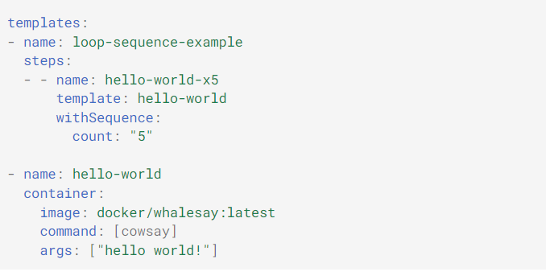
..

Slide 107
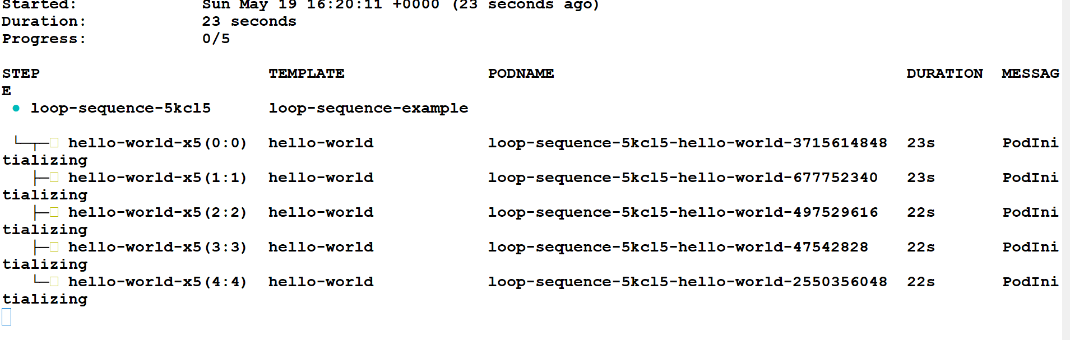
..

Slide 108
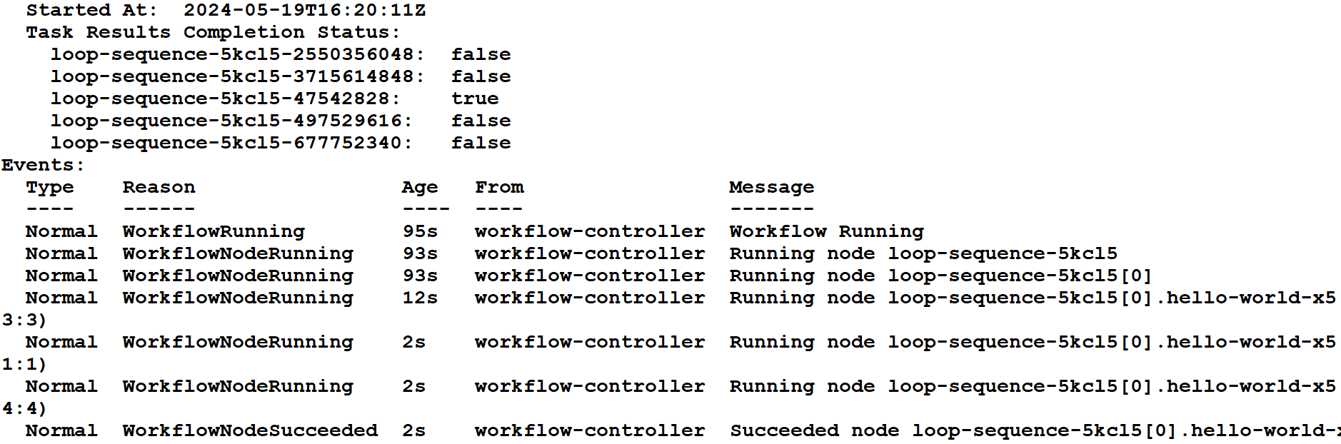
..

Slide 109
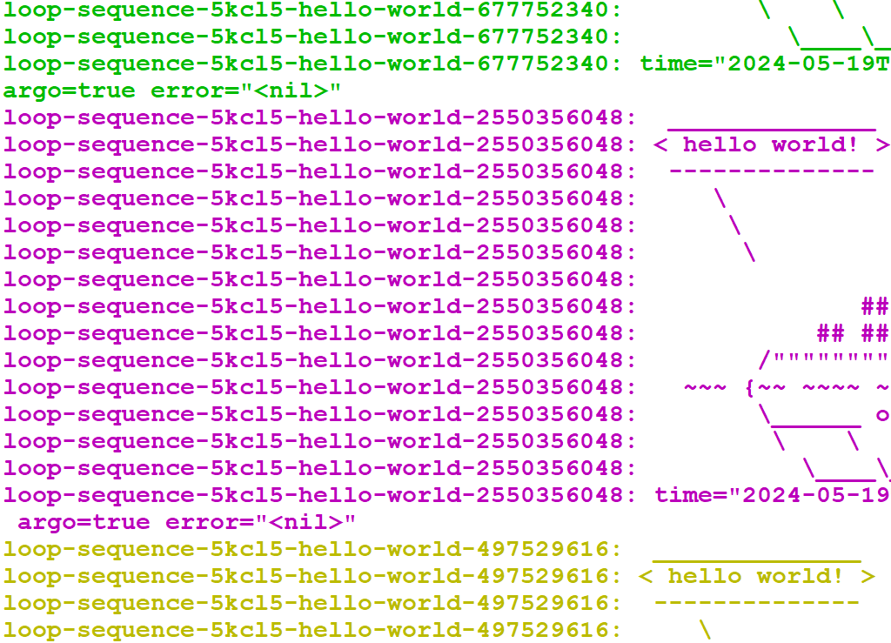
..

Slide 110
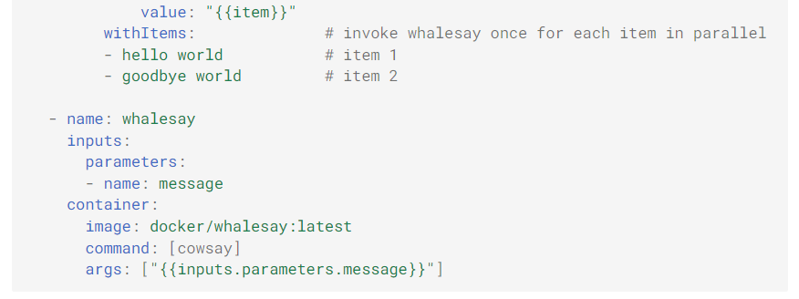
..

Slide 111

..

Slide 112

..

Slide 113
Lab 15
Multiple Examples of different types of iteration

Slide 114

Conditional statement
conditional execution with complex syntax implemented by govaluate.

Slide 115

..

Slide 116


Slide 117

..

Slide 118

Recursive

Slide 119

..

Slide 120

..

Slide 121
Lab 16
Conditional statement
Recursive: Until conditional matches

Slide 122
Error Handling and Workflow Management in Argo
Retry Mechanisms:Automatically re-running a failed step a certain number of times to try and complete it successfully.
limit:
What it is: The maximum number of times a step will be retried if it fails.
Example: limit: 3 means the step will be retried up to 3 times.

Slide 123
..
retryPolicy:
What it is: Specifies the conditions under which a step will be retried.
Options:
Always: Retries on both errors and failures.
OnFailure: Retries only on step failures (default).
OnError: Retries only on errors.
Example: retryPolicy: OnFailure means the step will retry only if it fails.

Slide 124
In Argo Workflows, the backoff mechanism uses an exponential back-off strategy. This means that when a task fails, the system waits for a certain duration before retrying it. If the task fails again, the wait duration increases exponentially with each subsequent failure.
nodeAntiAffinity prevents running steps on the same host. Current implementation allows only empty nodeAntiAffinity (i.e. nodeAntiAffinity: {}) and by default it uses label kubernetes.io/hostname as the selector.

Slide 125

..

Slide 126
Exit handlers
An exit handler is a template that always executes, irrespective of success or failure, at the end of the workflow.
Some common use cases of exit handlers are:
cleaning up after a workflow runs
sending notifications of workflow status (e.g., e-mail/Slack)
posting the pass/fail status to a web-hook result (e.g. GitHub build result)
resubmitting or submitting another workflow

Slide 127

Timeouts
You can use the field activeDeadlineSeconds to limit the elapsed time for a workflow:

Slide 128

..
You can limit the elapsed time for a specific template as well:

Slide 129


Slide 130

..

Slide 131

Exit handler

Slide 132

Retry watch command

Slide 133

..

Slide 134

..

Slide 135
Lab 17
Error Handling
Retry

Slide 136
WorkflowTemplate
Overview: Predefined blueprint for entire workflows, which can be used to create the workflow
Two types of WorkflowTemplate
WorkflowTemplate
ClusterWorkfloTemplate

Slide 137
Definition
ClusterWorkflowTemplates are like master blueprints for workflows that you can use across the entire cluster, similar to how a master key works for all the rooms in a building.
Once created at the cluster level, they can be used in any namespace within the cluster, making them accessible from anywhere in your system.
WorkflowTemplates are like ready-made instructions for tasks in your cluster. They act as templates that you can reuse whenever you need to perform certain tasks. You can think of them as pre-designed plans that you can quickly use to carry out specific actions within your system

Slide 138

Template vs Workflowtemplate

Slide 139

Syntax

Slide 140
Across release
In versions 2.7 and later, WorkflowTemplates support all fields in WorkflowSpec except for the "priority" field. This means that you can use WorkflowTemplates to define workflows with a wide range of configurations, making them more versatile and powerful for managing your workflows in Argo Workflows.
In versions 2.4 to 2.6, WorkflowTemplates were limited to containing only the "templates" and "arguments" fields. They couldn't include other fields like "entrypoint" that are found in a full Workflow definition.
So, if you tried to use a WorkflowTemplate in versions 2.4 to 2.6 that included an "entrypoint" field, it wouldn't be considered a valid WorkflowTemplate because those versions didn't support the "entrypoint" field in WorkflowTemplates.

Slide 141
cmds
argo template create argo-wftemp1.yaml
argo template list
argo template lint argo-wftemp1.yaml

Slide 142
Lab 18
Multiple Workflow example
Notes:
88

Slide 143

ClusterWorkflowTemplate
ClusterWorkflowTemplates are cluster scoped WorkflowTemplates. ClusterWorkflowTemplate can be created cluster scoped like ClusterRole and can be accessed across all namespaces in the cluster.

Slide 144
A `ClusterWorkflowTemplate` is a resource in Argo Workflows that defines reusable workflow templates at the cluster level.
- You can reference templates defined in other `ClusterWorkflowTemplates` using the `templateRef` field.
- When referencing a template from another `ClusterWorkflowTemplate`, you specify the name of the template and set `clusterScope: true` to indicate that the reference is at the cluster level.

Slide 145
Lab19
ClusterWorkflowTemplate Example
With DAG

Slide 146
CronWorkflow
CronJobs: Think of these like timers. They tell the computer to do something at certain times or on a regular schedule, like running a program every hour or every day.
CronWorkflows: Now, imagine combining a workflow (the sequence of tasks) with a timer (like CronJobs). This creates a CronWorkflow, which is a set of tasks that automatically runs based on a schedule you set. It's like having a recipe that the computer follows at specific times without you having to start it manually each time.

Slide 147

..

Slide 148


Slide 149

Lab20
Lab for CronJob

Slide 150
Argo Agent
HTTP Templates in Argo Workflows use the Argo Agent to execute HTTP requests. The Argo Agent works independently of the main controller and handles these requests.
When a Workflow needs the Argo Agent, a WorkflowTaskSet Custom Resource Definition (CRD) is created. This CRD helps the Agent and the Workflow Controller communicate effectively.
To Use the Argo Agent, must setup RBAC in Arog workflow. This involves adding a role for the agent in RBAC configuration

Slide 151

..

Slide 152

..

Slide 153
lab21
Perform with UI
Perform with CLI

Slide 154
ContainerSet
A container set template in Argo Workflows lets you run multiple containers together inside a single pod. This means all these containers will run on the same server (or node) in your Kubernetes cluster.
Since these containers share the same pod, you can use simple and efficient storage options like empty-dir volumes. These volumes are quick to set up and don't require persistent storage like persistent volume claims (PVCs). Empty-dir volumes are temporary storage that exists only for the duration of the pod, making them cheap and fast for sharing data between the containers in your workflow steps.

Slide 155

..

Slide 156

..
This workflow demonstrates using a container set template to run multiple containers in the same pod, share data between them using an emptyDir volume, and capture output for further processing.

Slide 157
Lab22
ContainerSet
Retry option

Slide 158
The Emissary Executor
The Emissary Executor in Argo Workflows is a specialized execution engine designed to handle complex workflows efficiently. Here's a detailed explanation of the Emissary Executor:
Workflow Execution:
The Emissary Executor is responsible for executing workflows defined in Argo Workflows.It manages the scheduling, execution, and coordination of workflow tasks and containers.
Task Parallelism:
Emissary supports parallel execution of tasks within a workflow.It can handle multiple tasks running simultaneously, optimizing resource utilization and workflow performance

Slide 159


Slide 160
..
Lab 23 for RM

Slide 161
Argo Events
Argo Events helps automate reactions to various events in your Kubernetes system
Imagine you have a system in Kubernetes where certain events can happen, like receiving a webhook, a file being dropped in an S3 bucket, or a scheduled task like a cron job.

Slide 162
Types of Events Supported
Argo Events supports over 20 types of events
Over 20 Event Types:
Webhooks (HTTP requests)
File drops in storage (like S3 buckets)
Scheduled tasks (cron jobs)
Messaging systems (Kafka, Google Cloud PubSub, Amazon SNS, SQS)

Slide 163
Event Source
Webhook: Triggered by an HTTP request
S3 Bucket: Triggered when a file is added
Cron: Triggered at scheduled times
Messaging: Triggered by messages in Kafka, PubSub, etc.

Slide 164
Actions Triggered by Events
What Actions Can Argo Events Trigger?
Create Kubernetes objects (Pods, Deployments)
Invoke workflows (using Argo Workflows)
Run serverless workloads
Examples:
A webhook triggers the creation of a new Pod
A file in S3 triggers a workflow to process the file
A cron job triggers a serverless function to run

Slide 165
Main Components of Argo Events
Components Overview:
Event Source
Sensor
Eventbus
Trigger

Slide 166
Event Source
Event source as anything that can generate events. Examples include a new file being uploaded to cloud storage, a message arriving in a queue, or a timer going off.
Configuration:
Define an EventSource with necessary configurations to connect to external event sources.
Specify authentication details, endpoints, and settings.
Example:
Configuring an S3 bucket EventSource to listen for new file uploads.

Slide 167
..
apiVersion: argoproj.io/v1alpha1
kind: EventSource
metadata:
name: s3-events
spec:
s3:
example:
bucket: my-bucket
region: us-west-2

Slide 168

Sensors
Sensors are configured to listen for specific events from one or more event sources. When the specified events occur, the sensor triggers predefined actions, known as triggers

Slide 169
How Sensors Works?
Define Event Sources: First, you define what events you are interested in. This could be an HTTP request, a message in a queue, a change in a Git repository, etc.
Create a Sensor: The sensor is configured to listen for the events from the defined event sources. You specify the conditions under which the sensor should act.
Define Triggers: Triggers are the actions that should happen when the sensor detects the specified events. This could be starting a workflow, sending a notification, or running a script.

Slide 170
Example
Let's say you want to start a data processing workflow whenever a new file is uploaded to an Amazon S3 bucket. Here’s how you can set it up:
Event Source: Define an event source for the S3 bucket that detects new file uploads.
Sensor: Create a sensor that listens for events from the S3 event source.
Trigger: Set up a trigger that starts the data processing workflow when the sensor detects the file upload event

Slide 171
EventBus(Optional)
Acts as a middleware for event routing and persistence.
Provides reliability and scalability.
Examples: NATS, Kafka.

Slide 172
EventSource
apiVersion: argoproj.io/v1alpha1
kind: EventSource
metadata:
name: s3-event-source
spec:
s3:
example:
bucket: my-bucket
event: s3:ObjectCreated:*

Slide 173
EventBus
apiVersion: argoproj.io/v1alpha1
kind: EventBus
metadata:
name: default
spec:
nats:
native:
replicas: 1

Slide 174
NATS
NATS is a lightweight and high-performance messaging system that is commonly used for building distributed systems and microservices architectures. Here are some key points about NATS:
apiVersion: Specifies the version of the Argo API being used, in this case, argoproj.io/v1alpha1.
kind: Indicates the type of resource being defined, which is an EventBus.
metadata: Contains metadata about the EventBus, such as its name (default in this case).
spec: Describes the specifications or configuration of the EventBus.
nats: Specifies that NATS will be used as the messaging system for this EventBus.
native: Configures NATS with specific settings:
replicas: Sets the number of NATS server replicas to 1.

Slide 175

Sensor and trigger

Slide 176
Projects
Lab 26: Project CI
Lab 27: Project Kubectl
Lab 28 : CICD pipeline
Lab 29: Project kuberentes Jobs

